Slide 1
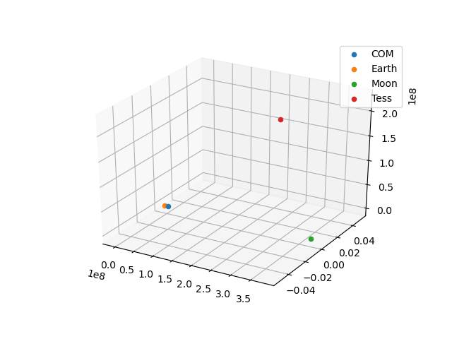
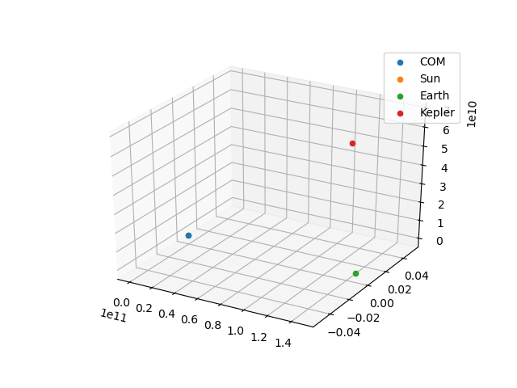
Satellite Orbits
Davy Rodelo-Sandoval

Slide 2
Tess and Kepler orbits 3d
Keplerian Orbits
Runge-Kutta Method
3D Scatter Plot (changes with time)
4 Animated Plots: Focus on Larger Bodies vs Focus on Satellites
4 Jupyter notebooks for each animation
Each notebook displays a stationary 3D scatter plot and animation

Slide 3
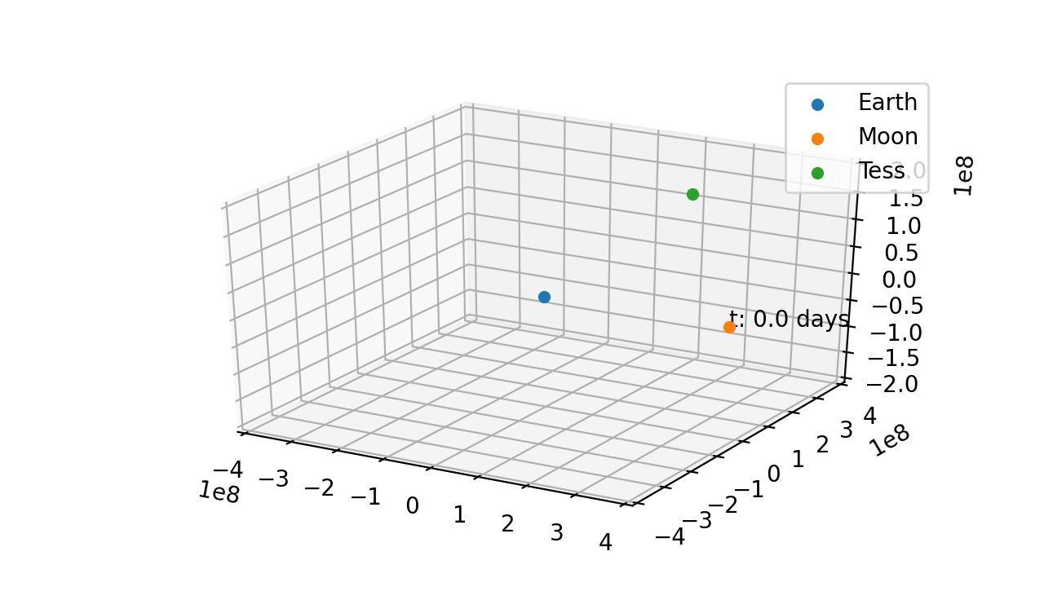
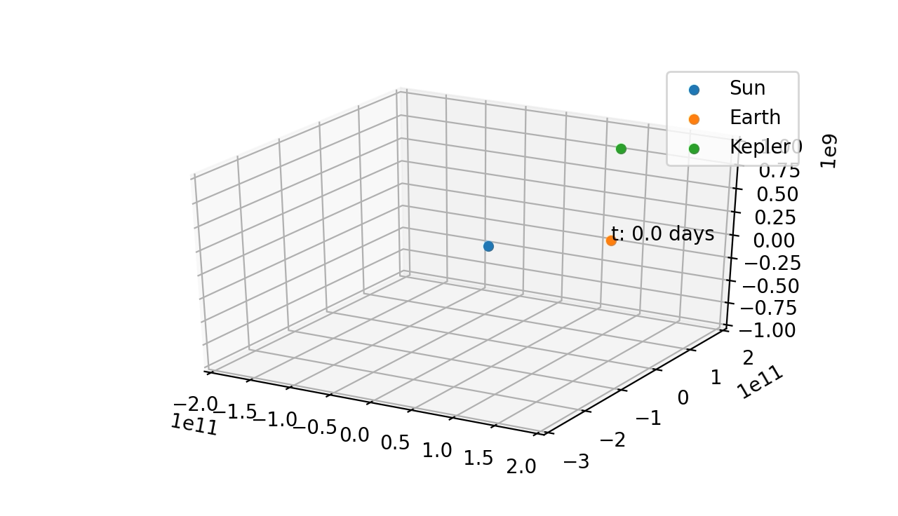
Moon, Earth Focus

Slide 4
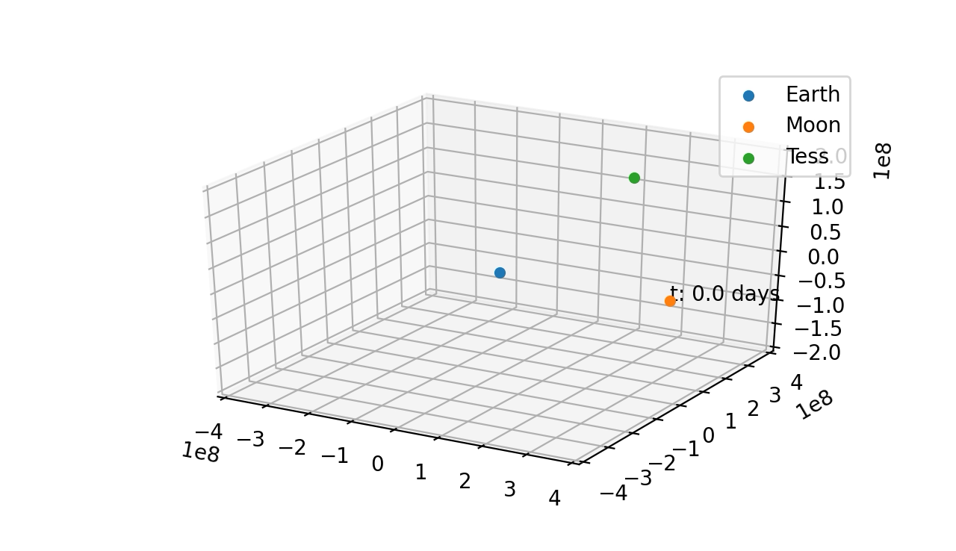
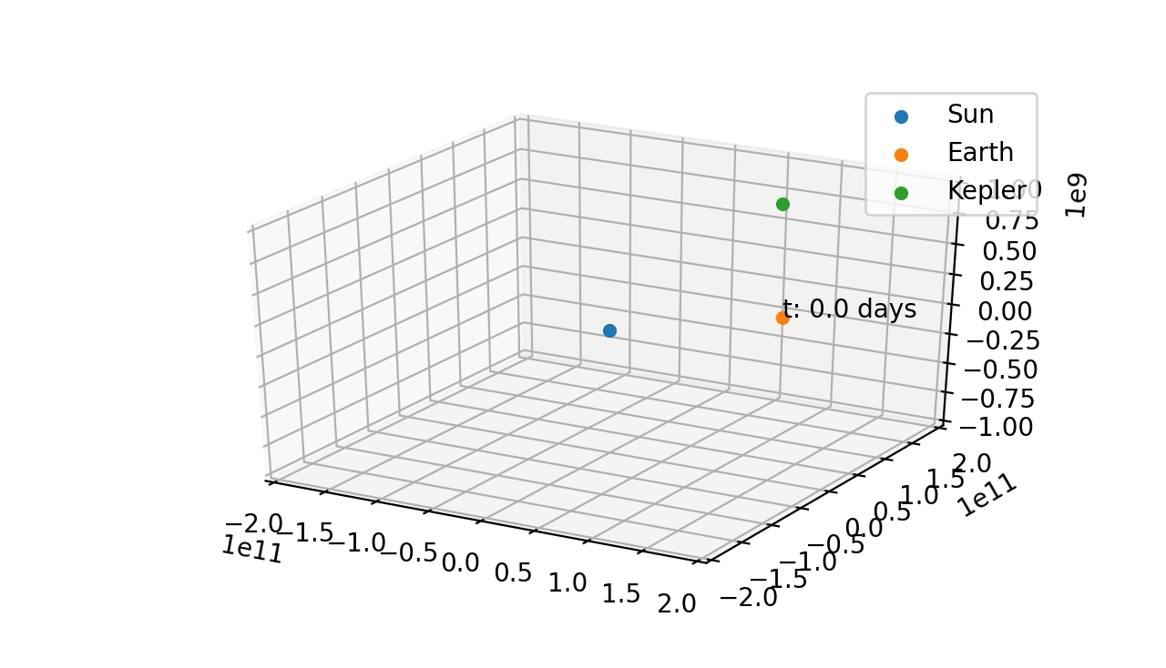
Satellite Focus

